Slide 1
Image Steganography
based on Block-DCT and Huffman Encoding

Slide 2
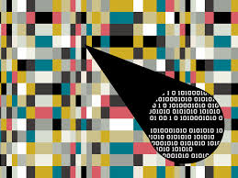
Problem Statement:
Hiding information into a cover image for providing security. Because It doesn’t seem fishy enough for hackers to see a normal image as it contains any secret information, it becomes more important for the users to maintain privacy. And to provide such security and privacy to the user, hiding information in an image and transmitting to other is very important to protect from any unauthorized user access.
Hiding information into a cover image using Block – DCT and Huffman Encoding as this algorithm show that the information has a high capacity and a good invisibility.

Slide 3
Literature Survey:
Steganography is the art and science of hiding information in a cover document such as digital images in a way that conceals the existence of hidden data.
The word steganography in Greek means “covered writing” (Greek words “stegos” meaning “cover” and “grafia” meaning “writing”).
The main objective of steganography is to communicate securely in such a way that the true message is not visible to the observer.
That is unwanted parties should not be able to distinguish in any sense between cover-image (image not containing any secret message) and stego-image (modified cover-image that containing secret message).
Thus, the stego-image should not deviate much from original cover-image, So we are using Steganography using 2d – DCT and Huffman Coding.
Today steganography is mostly used on computers with digital data being the carriers and networks being the high-speed delivery channels.

Slide 4
Flow chart(Embedding Algorithm):
Cover Image
Divide into 8*8 Blocks
Apply 2D - DCT
Quantizer(Q50)
Zig-Zag Scanning
LSB Data Embedding
Apply Inverse 2D - DCT
Stego -Image
Secret Image
Apply Huffmann Encoding
Hufmann Code
Apply Inverse Quantizer(~Q50)
Quantizer(Q50)

Slide 5
Flow chart(Extraction Algorithm):
Stego Image
Divide into 8*8 Blocks
Apply 2D - DCT
Quantizer(Q50)
Zig-Zag Scanning
LSB Data Extraction
Pixels in Excel
Secret Image
Secret Image
Hufmann Decoding
Quantizer(Q50)
Hufmann Decoding
Pixels in Excel

Slide 6
Methodology:
Input: An M1×N1 carrier image and a secret message/image.
Output: A stego-image.
1. Obtain Huffman table of secret image.
2. Find the Huffman encoded binary bit stream of secret-image by applying Huffman encoding technique using Huffman table obtained in step 1.
3. Calculate size of encoded bit stream in bits.
4. Divide the carrier image into non overlapping blocks of size 8×8 and apply DCT on each of the blocks of the cover image.
5. Repeat for each bit obtained in step 3 (a) Insert the bits into LSB position of each DCT coefficient of 1 st 8×8 block
6. Decompose the encoded bit stream of secret message/image obtained in step 2 into 1-D blocks of size 8 bits.
7. Repeat for each 8-bit blocks obtained in step 6 (a) Change the LSB of each DCT coefficient of each 8×8 block(excluding the first) found in step 4 to a bit taken from left(LSB) to right(MSB) from each 8 bit block B.
8. Repeat for each bit of the Huffman table (a) Insert the bits into LSB position of each DCT coefficient
9. Apply inverse DCT using identical block size.

Slide 7
Methodology:
Input: An M1×N1 Stego-image.
Output: Secret image.
1. Divide the stego-image into non overlapping blocks of size 8×8 and apply DCT on each of the blocks of the stego-image.
2. The size of the encoded bit stream is extracted from 1 st 8 × 8 DCT block by collecting the least significant bits of all of the DCT coefficients inside the 1 st 8×8 block.
3. The least significant bits of all of the DCT coefficients inside 8×8 block (excluding the first) are collected and added to a 1-D array.
4. Repeat step 3 until the size of the 1-D array becomes equal to the size extracted in step 2.
5. Construct the Huffman table by extracting the LSB of all of the DCT coefficients inside 8×8 blocks excluding first block and the block mentioned in step 3.
6. Decode the 1-D array obtained in step 3 using the Huffman table obtained in step 5.

Slide 8
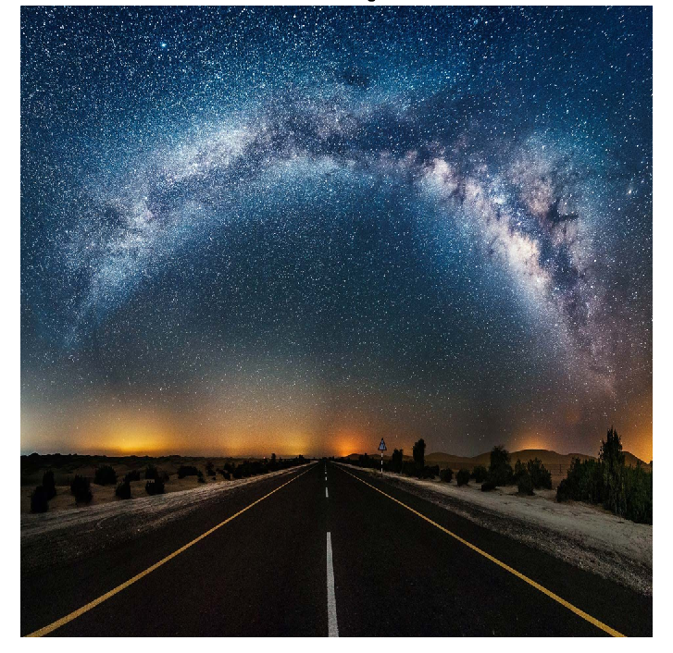
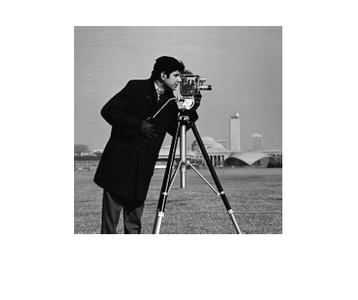
Result:
Inputs:
Figure 1: Cover Image of Resolution 1024*1024
Figure 1: Secret Image of Resolution 256*256

Slide 9
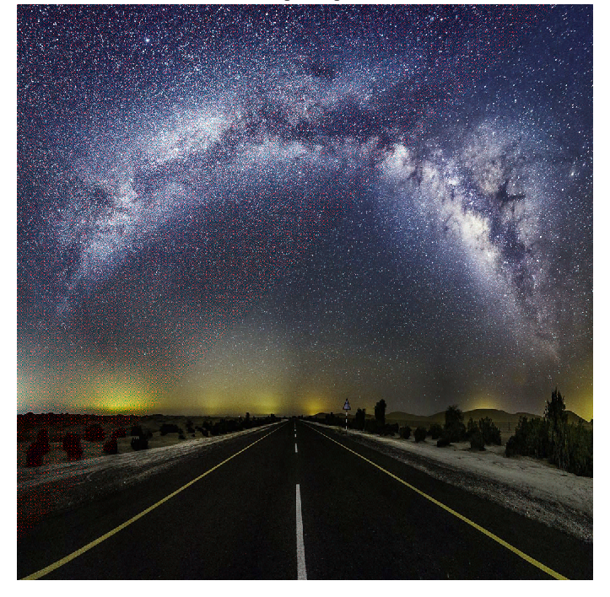
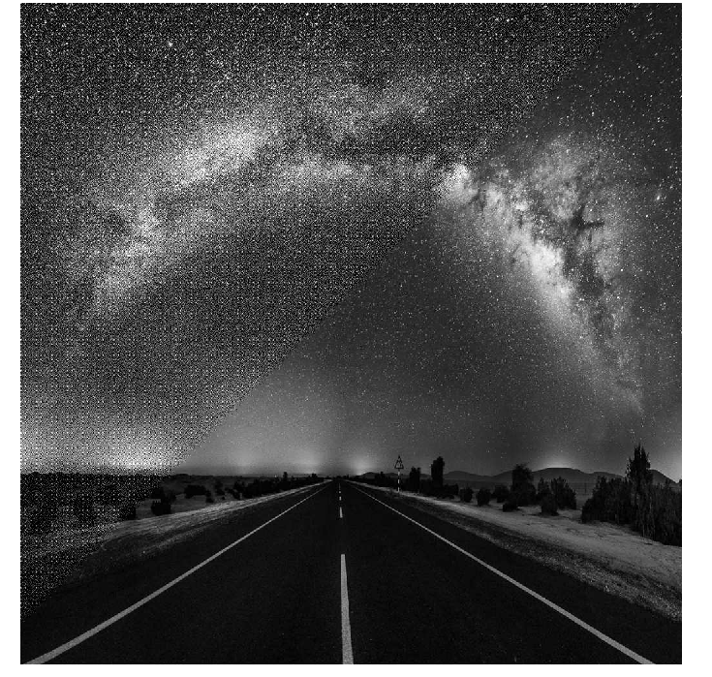
Outputs:
Figure 3 Grey Scaled Stego Image of Resolution 1024*1024
Figure 4 Stego Image of Resolution 1024*1024

Slide 10
Outputs:
Figure 5: Secret Image of Resolution 256*256

Slide 11
References:
Danny Adiyan Z.1 , Tito Waluyo Purboyo2 and Ratna Astuti Nugrahaeni International Journal of Applied Engineering Research ISSN 0973-4562 Volume 13, Number 1 (2018) pp. 442-448 © Research India Publications. http://www.ripublication.com
Devadath C Prabhu Department of CS&E, PESIT South Campus, Bengaluru, India Multiple Image Steganography using LSB-DCT Technique, International Journal of Engineering Research & Technology (IJERT) ISSN: 2278-0181 Published by, www.ijert.org ICACT - 2016 Conference Proceedings
Ketaki Bhaskar, Mitali Bakale, Priyanka Chaure, Priti Shirke Image Steganography for data hiding Using Huffman code, Zigzag and OPAP International Journal of Emerging Trends & Technology in Computer Science (IJETTCS) Volume 4, Issue 6, November - December 2015 ISSN 2278-6856
Deepak Singla, Rupali Syal /Data Security Using LSB & DCT Steganography In Images International Journal Of Computational Engineering Research/ ISSN: 2250–3005
Papakostas, George & Koulouriotis, Dimitrios & Karakasis, Evangelos G.. (2009). Efficient 2-D DCT Computation from an Image Representation Point of View. 10.5772/7043
Poljicak, A., Botella, G., Garcia, C. et al. J Real-Time Image Proc (2016). doi:10.1007/s11554-016-0616-9
Chan, C.K. and Cheng. L.M. 2003. Hiding data in image by simple LSB substitution. Pattern Recognition, 37: 469 – 474.

Slide 12
Done by:
J. D. P. Rithvik 17BEC0223
T . Hari Maheswar Reddy 17BEC0379
B . Siva Anil Kumar Reddy 17BEC0117

